Slide 1
Seasons

Slide 2
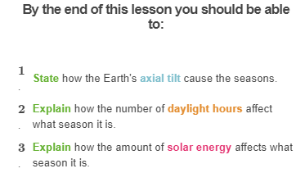


Slide 3
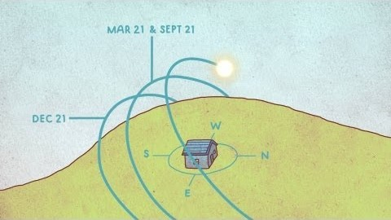

Slide 4
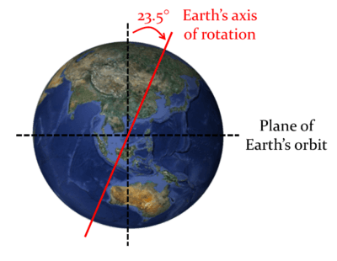
Remember, the Earth rotates around an imaginary line called an axis.
Earth's axis is tilted on an angle of 23.5° from vertical. As the Earth orbits the Sun the angle of its axial tilt remains the same.
The Earth's axial tilt is the main reason for the seasons!

Slide 5
Seasons are periods of the year marked by specific weather patterns, temperatures, and day lengths.
The Earth has two main seasonal patterns.
Places close to the Equator (the tropical zones) experience two different seasons: the wet and dry seasons.
Places further from the Equator (the temperate zones) experience four different seasons: spring, summer, autumn and winter.

Slide 6
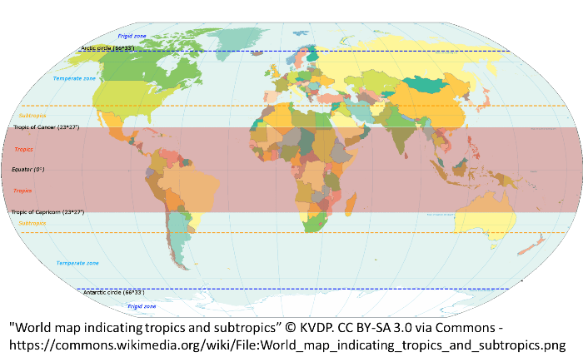

Slide 7
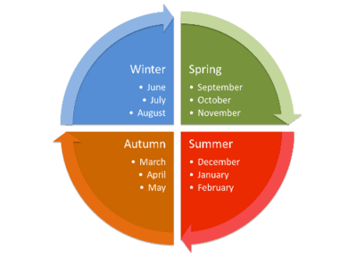
Australia is a very large country, so different areas experience different seasonal patterns.
Places near the top of Australia (near the Equator) experience the wet and dry seasons. The wet season occurs from November to March, and the dry season from April to October.
Places nearer the bottom of Australia experience spring, summer, autumn and winter. This lesson will focus on the areas that experience these seasons.

Slide 8
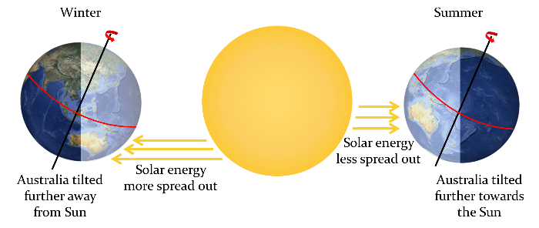
Australia is in the southern hemisphere.
When the South Pole is pointing towards the Sun, it is summer in the southern hemisphere.
When the South Pole is pointing away from the Sun, it is winter in the southern hemisphere.

Slide 9
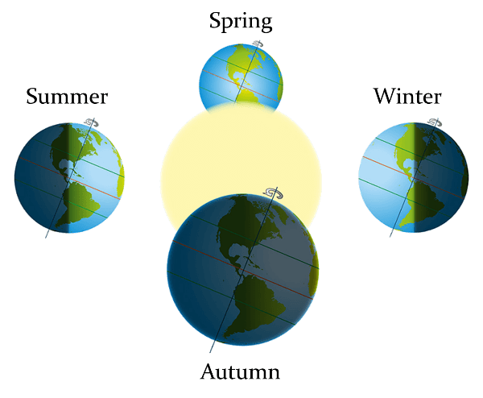
The seasons in the Northern Hemisphere are the opposite of those in the Southern Hemisphere.
When the North Pole is pointing toward the Sun, it is summer in the northern hemisphere. At the same time, the South Pole is pointing away from the Sun.
This means that, when it is summer in the northern hemisphere, it is winter in the southern hemisphere, and when it is winter in the northern hemisphere it is summer in the southern hemisphere!

Slide 10
How does the Earth's tilt contribute to the climate at different times of the year?
There are two main reasons. The first is because the tilt of the Earth determines how long the Sun shines on different areas.
When the Sun is shining on the Earth (i.e. during day time), the Earth heats up. When the Sun sets, the Earth cools down.

Slide 11
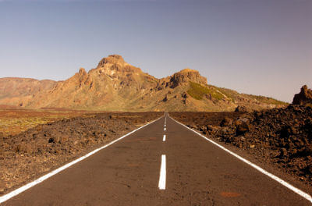
When the southern hemisphere is pointing towards the Sun, it gets more daylight hours than hours of darkness.
For example, Tasmania gets about 15 hours of daylight and 9 hours of darkness in summer.
This means that in summer, the Earth warms up for longer than it cools, which leads to an overall warming effect on the Earth when it happens day after day.

Slide 12
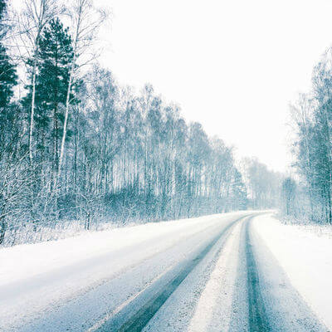
When the southern hemisphere is pointing away from the Sun, it gets fewer daylight hours than hours of darkness.
For example, Tasmania gets about 9 hours of daylight and 15 hours of darkness in winter.
This means that in winter, the Earth cools down for longer than it warms, which leads to an overall cooling effect on the Earth when it happens day after day.

Slide 13
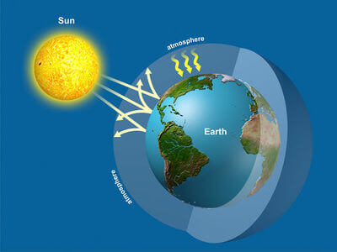
The second reason is the amount of solar energy received by different areas of the Earth.
Solar energy is the energy from the Sun, and this is what we feel as heat. Solar energy heats up the Earth.

Slide 14
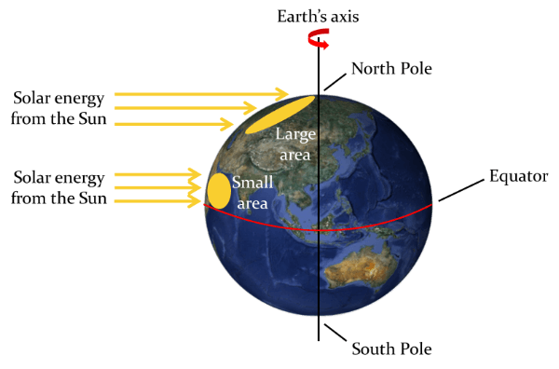
Earth is a sphere, and the Sun shines on it from the side.
This means that in areas near the top and bottom of the sphere (the North and South Poles), the solar energy is more spread out than it is near the middle of the sphere (the equator).
The more spread out the solar energy is, the less energy is delivered to each square kilometre of Earth, and the less that area can heat up. This is why the poles are colder than the equator.

Slide 15
During summer, Australia is tilted further towards the Sun, which means that the Sun shines on it more directly, heating it up more.
During winter, Australia is tilted further away from the Sun, which means that the Sun shines on it less directly, heating it up less.

